Slide 1




MALNAD COLLEGE OF ENGINEERING
AI Chatbot For
College Event Reminder
Guided By:
Mrs. Harshitha S
Assistant Professor
Submitted By:
Janavi H Gowda
Hajira Kulsum
Apeksha H S
P Sharanabasappa

Slide 2
ABSTRACT
In the rapidly evolving field of artificial intelligence, chatbots have become essential tools for enhancing user engagement and operational efficiency. This project introduces an advanced chatbot designed for departmental event management and personalized reminders. By integrating natural language processing (NLP) with a robust memory architecture, the chatbot can store and manage event-related information based on user-specified dates, keeping students and faculty informed about relevant activities. Additionally, it offers personalized reminders tailored to individual preferences and schedules. Inspired by recent advancements in chatbot memory structures, particularly narrative memory, this initiative aims to create a chatbot that not only shares information but also provides a more interactive and personalized experience in the academic environment.

Slide 3
LITERATURE SURVEY
Paper Title and author | Publication and year | Advantages | Methodology Used | Drawbacks/Limitations
Teach AI How to Code: Using LLMs as Teachable Agents for Programming Education Hyoungwook Jin et al. | arXiv (Preprint, 2023) | Facilitates learning by teaching; identifies knowledge gaps | Prompting pipeline to restrain LLM knowledge; TeachYou and AlgoBo systems | LLMs' expansive knowledge may discourage learner teaching
Using AI Chatbots in Education: Recent Advances, Challenges, and Use Cases | MDPI or IEEE (Journal/Conference, 2024) | Comprehensive overview of latest advances; practical educational applications; highlights challenges like data privacy and ethical concerns. | Review of state-of-the-art LLMs and NLP techniques; focus on transformer architectures like GPT and BERT; case studies of real-world chatbot implementations. | Data security issues; bias and fairness concerns; dependency on data quality and quantity.
An Intelligent Chat-bot using Natural Language Processing Rishabh Shah et al. | International Journal of Engineering Research (Journal, 2017) | Understands queries in text and speech formats | NLP techniques; keyword recognition | Limited to specific domains; scalability issues

Slide 4
LITERATURE SURVEY
Paper Title and author | Publication and year | Advantages | Methodology Used | Drawbacks/Limitations
Chatbot-based College Information System Ram Manoj Sharma | RESEARCH REVIEW International Journal of Multidisciplinary (Journal, 2019) | Provides conversational interface for college-related queries. | AI and machine learning algorithms; database-driven responses | Limited to predefined responses; may not handle complex queries
A Review on the Use of Large Language Models as Virtual Tutors | Science & Education (Journal, 2024) | Application of LLMs as virtual assistants in education | Use of GPT-3, BERT, SBERT, MathBERT models | Potential negative impact on learning processes
UNISEL Bot: Designing Simple Chatbot System for University FAQs Norshima Zakaria, Noraini Ibrahim, Sharifah Abdullah | International Journal of Interactive Mobile Technologies (iJIM), 2020 | Simple, user-friendly interface; effectively answers common university questions; reduces staff workload | Rule-based system combined with NLP techniques for intent matching and FAQ retrieval | Limited to pre-defined FAQ scope; lacks advanced understanding or context awareness

Slide 5

PROBLEM STATEMENT
Despite the increasing availability of information through traditional college communication channels, such as manual announcements, emails, and notice boards, students often face challenges in accessing timely and relevant information regarding admissions, course offerings, campus activities, and academic support. These traditional reminder systems can lead to missed deadlines, reduced engagement, and scheduling conflicts, as faculty members struggle to keep track of lectures and meetings, while students frequently forget exam dates, assignment deadlines, and extracurricular activities. This gap highlights the need for an intelligent, user-friendly chatbot solution that leverages artificial intelligence and natural language processing to facilitate seamless communication, enhance student engagement, and streamline information dissemination within educational institutions.

Slide 6

OBJECTIVES
Develop a Memory-Enhanced Chatbot
Implement Personalized Reminder Systems
Construct a chatbot capable of storing and retrieving departmental event information, utilizing advanced memory structures to maintain context and continuity in conversations. This approach aligns with findings that emphasize the importance of memory retention in sustaining meaningful dialogues over multiple interactions.
Design a system that delivers tailored reminders to users about upcoming events, assignments, and deadlines, thereby enhancing individual time management and organizational skills. The effectiveness of personalized reminders has been demonstrated in various applications, including support for individuals with cognitive impairments.
Ensure Data Security and Privacy
Evaluate Performance and User Satisfaction
Implement robust data protection measures to safeguard user information, adhering to best practices in data security and privacy regulations.
Conduct comprehensive testing and user feedback sessions to assess the chatbot’s performance, accuracy in event retrieval, effectiveness of reminders, and overall user satisfaction, ensuring continuous improvement and alignment with user needs.

Slide 7
OBJECTIVES
Multi-language Support
Voice Assistant Integration
Enables communication in multiple regional or user-preferred languages.
Uses NLP-based translation for real-time interpretation and response.
Improves inclusivity for users from diverse linguistic backgrounds.
Tools Used: Google Translate API, Multilingual BERT..
Adds speech-to-text and text-to-speech capabilities.
Allows users to interact with the chatbot using voice commands.
Enhances accessibility for mobile users and individuals with visual impairments.
Tools Used: Google Speech API, Mozilla DeepSpeech.
Smart Group Reminders & Event Planning
Identify groups of users with similar academic or extracurricular interests using clustering techniques. Send targeted event reminders to these groups and suggest group-based event opportunities. Increases engagement and ensures more relevant communication.

Slide 8
TECHNICAL REQUIRMENTS
Natural Language Processing:
Understanding of NLP concepts and techniques for processing user input and generating responses.
Machine Learning:
Knowledge of machine learning algorithms and model training to improve the chatbot's response accuracy over time.
Database Management:
Familiarity with database design and management for storing user interactions and chatbot responses.
User Interface Design:
Skills in designing user-friendly interfaces for both web and mobile applications to enhance user experience.
API Integration:
Ability to integrate third-party APIs for additional functionalities, such as sending email transcripts or notifications.
Testing and Debugging:
Proficiency in testing methodologies to ensure the chatbot functions correctly and efficiently under various scenarios.

Slide 9
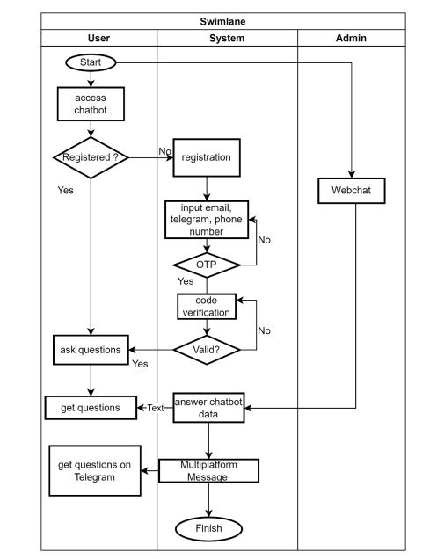
METHODOLOGY
Logged in?
Login
Input name, USN and Password
..

Slide 10
REFRENCES
[1] Nur Azizul Haqimi, Rendra Tri Kusuma (2025), “Timeline Reminder System Bot and Telegram Assistant Chatbot for University Students and Lecturers”, Universitas Sebelas Maret.
[2] Shivranjani Sunderrajan, Smriti Tiwari, Seema Bhatkar (2023), “AI-Based Students Chatbot”, Vidyalankar School of Information Technology.
[3] S. Matilda, Harish A (2023), “Chatbot for College Management System Using AI”, IFET College of Engineering.
[4] Ram Manoj Sharma (2023), “Chatbot-Based College Information System”, DAV College, Malout.
[5] Andy Nguyen, Marios Kremantzis, Aniekan Essien, Ilias Petrounias, Samira Hosseini (2023), “Enhancing Student Engagement Through Artificial Intelligence (AI): Understanding the Basics, Opportunities, and Challenges”, Multinational Collaboration across Europe and Latin America.
[6] Nahdatul Akma Ahmad, Mohamad Hafiz Che Hamid, Azaliza Zainal, Zirawani Baharum (2023), “UNISEL Bot: Designing a Simple Chatbot System for University FAQs”, University Selangor (UNISEL), Malaysia.

Slide 11


Thank You

